Slide 1
Migrating & Integrating Java Applications in IBM Bluemix
Deepak Rai

Slide 2
Agenda
Cloud application best practices
What are the refactoring concerns when taking a Java app and moving it to the Cloud?
Migrating existing Java Apps to Bluemix
Cloud application – Debug and Sync
Load Testing cloud application
Notes:
What features are available in Bluemix to host my Java App ?
Cloud Foundry Runtimes
IBM Containers
Open Stack Virtual Machines
Is there anything available to help me move the app ?
Migration Toolkits
What are the changes I need to make to achieve cloud scale.
Our focus in this session is on Migration.
What is important prior to Migration? Go through Migration Questionnaire.
What is important during Migration ?
What is important post Migration?

Slide 3
12 Factor App Methodology
I. Codebase
One codebase tracked in revision control, many deploys
II. Dependencies
Explicitly declare and isolate dependencies
III. Config
Store config in the environment
IV. Backing Services
Treat backing services as attached resources
V. Build, release, run
Strictly separate build and run stages
VI. Processes
Execute the app as one or more stateless processes
VII. Port binding
Export services via port binding
VIII. Concurrency
Scale out via the process model
IX. Disposability
Maximize robustness with fast startup and graceful shutdown
X. Dev/prod parity
Keep development, staging, and production as similar as possible
XI. Logs
Treat logs as event streams
XII. Admin processes
Run admin/management tasks as one-off processes
Notes:
List 12 factors, 12 factor methodology is cross industry. Speak to each of them especially Backing Services
Making apps cloud ready is to ensure that they can run efficiently in the cloud.

Slide 4

Migration: Redeploying Existing On-premises Applications onto Bluemix
Cloud
Data Center
Notes:
What is the value in taking Apps that are running on premises, to the cloud ?
1. Cloud Apps can achieve impossible scale.
2. Cloud Apps are not constrained by physical asset resources like servers in a Data Center.

Slide 5
Migration Questionnaire
What runtimes are you migrating from?
What Application Server are you migrating from?
What is the motivation behind the migration,
Cost ?
Consolidation ?
Scale using the Cloud?
Runtime Features ?
Integration with Cloud Services ?
Notes:
Migrating an application to Bluemix requires several factors to be considered. As a starting point, you need to answer the above Questionnaire.
The purpose of this questionnaire is to gather basic information about your JEE applications, your JEE installations, and testing stages so we can better estimate the effort required to migrate them to WebSphere.
These questions help us to :
identify all of the artifacts that need to be migrated,
the degree to which those migrations can be automated,
the overall effort for doing the migration,
make the best choices on how to move your application to Bluemix

Slide 6
Migration Questions specific to the Application
What Java capabilities does your application use?
What external services and dependencies does it require?
Is your application cloud-ready?
How much investment are you willing to make to update your application for the cloud?
How much investment are you willing to make to update administrative procedures?
Notes:
Java capabilities includes JEE/nonJEE features leveraged in your application. For example, EJBs, Servlets, JSPs, Frameworks used namely Spring, GWT etc.
What Authentication model is used by the App. For example, Oauth, SAML.
Specific features used e.g. Spring Boot, Spring Security.
External services used. For example, LDAP registry, Messaging Bus, MQ services, Databases etc.
Application specific questions to be answered by SMEs and System Administrators.
We walk through two flow charts, using several examples :
Legacy App runs on JDK 1.5, How to get this app running on the Cloud ? Specific JDK levels supported by runtime in the Cloud .This app is a good candidate for running on IBM Containers .
What is meant by Application being cloud ready ?
What steps are required to take a Java App and host it in the Cloud.

Slide 7
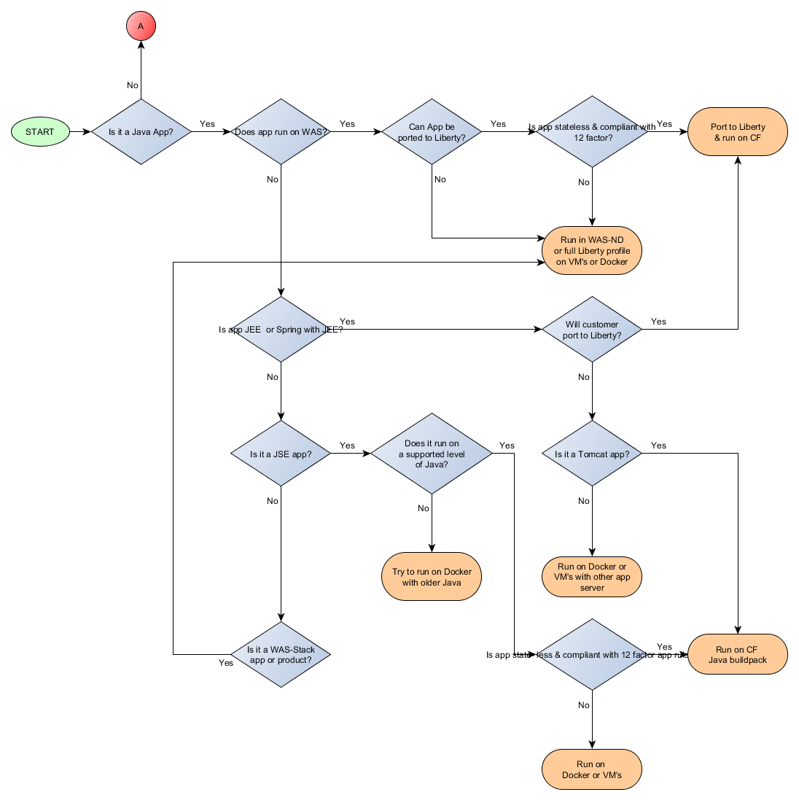
Migration Roadmap
Notes:
Go over examples for each landing point. Simple examples to show the aspects of your decision.
Many different starting points, Pick key highlights in each scenario.
It is a Java App→ Runs in WebSphere?→App can be ported to WAS Liberty → App is stateless & 12 factor compliant? →Port to Liberty runtime in Bluemix.
It is a Java App→ Runs in WebSphere?→App cannot be ported to WAS Liberty?→Run App on WAS-ND or Full Liberty profile in Docker Container or VMs
It is a Java App→ Does not run in WebSphere?→App is JEE/Spring with JEE→ Customer ready to port App to Liberty & make app Cloud ready → Port to Liberty runtime in Bluemix.
It is a Java App?→ Does not run in WebSphere?→App is not JEE nor Spring with JEE → App is JSE & runs on supported level of JDK? →App is stateless & 12 factor compliant → Run app on Java buildpack in Bluemix.
It is a Java App?→ Does not run in WebSphere?→App is not JEE nor Spring with JEE → App is JSE but does not run on supported level of JDK? →Run in Docker Container with older level of JDK.
It is a Java App→ Does not run in WebSphere?→App is JEE/Spring with JEE→ Customer Not ready to port App to Liberty→ It is a Tomcat App → Run app on Java buildpack in Bluemix.
It is a Java App→ Does not run in WebSphere?→App is JEE/Spring with JEE→ Customer Not ready to port App to Liberty → It is not a Tomcat App → Run app in Docker container or VM with other AppServer
It is a Java App?→ Does not run in WebSphere?→App is not JEE nor Spring with JEE → App is JSE & runs on supported level of JDK? →App is not stateless & not 12 factor compliant → Run on Docker Container or VM

Slide 8
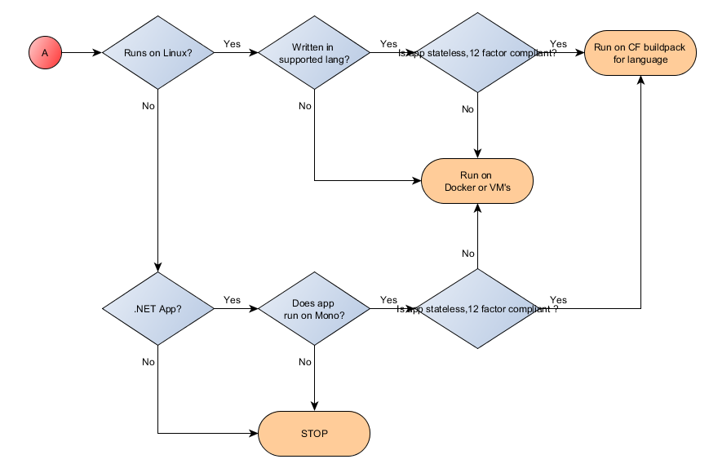
Migration Roadmap (cont.)
Notes:
It is not a Java App→ Runs on Linux → Written in a language supported in Cloud Foundry→ App is stateless & 12 factor compliant →Run on CF buildpack for the language
It is not a Java App→ Runs on Linux → Written in a language supported in Cloud Foundry→ App is not stateless & not 12 factor compliant →Run on Docker Container or VM
It is not a Java App→ Runs on Linux → Written in a language NOT supported in Cloud Foundry→ Run on Docker Container or VM
It is not a Java App→ Does not run on Linux → It is a .NET App → Runs on Mono buildpack → App is stateless & 12 factor compliant → Run on CF .NET buildpack
It is not a Java App→ Does not run on Linux → It is a .NET App → Doe not run on Mono buildpack → Don’t migrate to Bluemix
It is not a Java App→ Does not run on Linux → It is not a .NET App → Don’t migrate to Bluemix

Slide 9
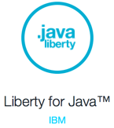
Liberty for Java Buildpack
In Bluemix, the Java runtime is called Liberty for Java
Runs the IBM WebSphere Application Server Liberty Profile v8.5.5.6
Implements full Java EE 7
Java EE 7 programming model support
Liberty Buildpack Updates: Java EE 7 is here!
Liberty does not include some Full profile features
They’re less strategic
Notes:
Now we are going to options for hosting applications in Cloud Foundry runtimes. The first level is : slide has 3 runtimes. 7 and 8 gave specifics of runtimes. 11 and 12 give details of the cloudfoundry runtimes.

Slide 10

Java buildpack for Tomcat applications
Cloud Foundry’s Java Buildpack v3.0
Buildpack includes Tomcat v8.0.21
Bluemix users can deploy an app to Tomcat
cf push <APP-NAME> -b java_buildpack

Slide 11
Agenda
What are the features of Bluemix available to host Java Apps in the Cloud ?
What is the Tooling available for migrating existing Java Apps to Bluemix?
What are the refactoring concerns when taking a Java app and moving it to the Cloud?
Notes:
Is there anything available to help me move the app ?

Slide 12
WAS Application Migration Toolkits(WAMT & WCMT)
Scans application source to provide:
High level evaluation report showing Java EE technologies your application uses
Line-by-line analysis of code changes required to migrate
with quick fix code changes where possible
Runs in Eclipse against application source
Command-line analysis of application binaries
High level evaluation report
Detailed analysis for migration to Liberty runtime in Bluemix
Download Toolkit from Eclipse Marketplace or wasdev.net
https://developer.ibm.com/wasdev/downloads/#asset/tools-Migration_Toolkit_Liberty_Tech_Preview
https://developer.ibm.com/wasdev/downloads/#asset/tools-Migration_Toolkit_for_Application_Binaries_Tech_Preview
Notes:
Question we are answering : What tooling is available to help with Migrating applications to Bluemix.
Migration Toolkit provides detailed analysis for features/technologies used in the app that cannot be migrated to the Cloud.

Slide 13

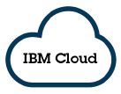






Tomcat application (RedbookLibrary)
TTTTT
On-Premises
SQL Database
13
Notes:
The Tomcat application, RedbookLibrary is running on-premises using Derby database. We run Tomcat Config Migration on Tomcat server as well as on the application to migrate the configuration to Liberty for Java runtime in Bluemix.
On slide 15, we will see the output from running the scanner on the Application binaries. On slide 16, we see the detailed analysis from the scanner tool.

Slide 14
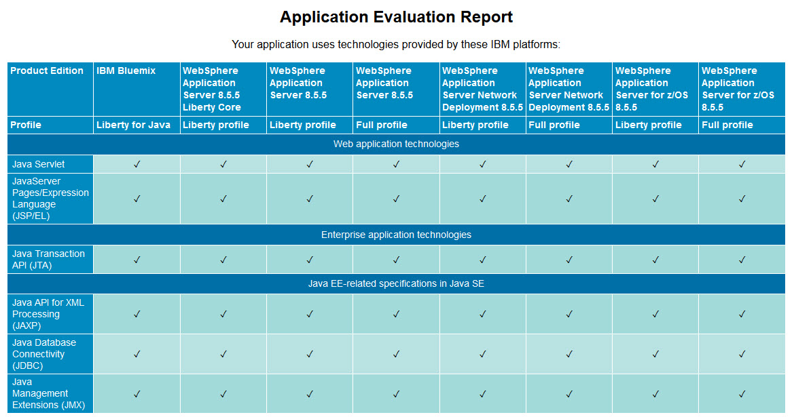
High Level Technology Analysis Results (in HTML)
Notes:
Migration analysis tools help in determining how easily an application will port to Bluemix. The first tool is a binary assessment tool, which we will run from the command line. The second tool provides more in-depth analysis, but requires the source code and Eclipse
Download the binary assessment tool from: https://developer.ibm.com/wasdev/downloads/#asset/tools-Migration_Toolkit_for_Application_Binaries_Tech_Preview
Install the tool: java -jar binaryAppScannerInstaller.jar
After installing, go to the wamt subdirectory
Run the analysis from the wamt subdirectory: java -jar binaryAppScanner.jar \directory-containing-war-file.
In the High Level Analysis report, under Web application technologies, we see that this application uses Servlets and JSP. This is not surprising for a Tomcat application. All the technologies will migrate to Liberty for Java on Bluemix, as shown in column 1.
Under Java EE-related specifications in Java SE, we see the application uses JDBC. This application will also run in Liberty for Java on IBM Bluemix, however, we will need to decide how to actually handle the database while the app runs in the Cloud.

Slide 15
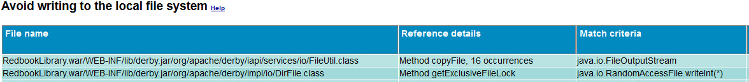
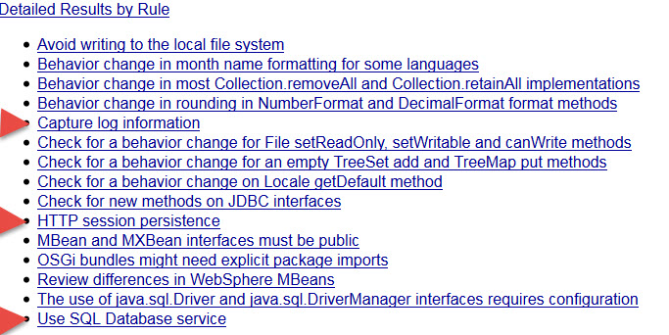
Notes:
Next, run a detailed analysis report, which highlights potential issues as you move to the cloud. The report includes filenames, line numbers, and reference material for resolving the reported problems.
From the wamt subdirectory, run : java -jar binaryAppScanner.jar \directory-containing-war-file --analyzeMigrationDetails --targetAppServer=bluemix. This also produces an HTML file.
The detailed analysis provides more information. Most of the areas flagged are from the local Derby database we used with Tomcat, and don't apply when we move to the cloud. You can see the rules that are flagged from derby files by looking at the File name detail.
For the database, the recommendation is to use the SQL Database service in Bluemix. This is exactly what we will do. We will the SQL Database Service in Bluemix.
The report also flags Capture Log Information as something to check in the application. When we look at the help, we see: "Applications can log to System.err/System.out so that Cloud Foundry's Loggregator component picks up the log entries. Using Loggregator, you can tail application logs and dump a recent set of application logs." In our application, we're using the standard Java logging facility and also logging to the default location, which is System.out. So it will be automatically picked up by the Loggregator.
The detailed report also flags session persistence. We will handle that by binding with session cache and auto scaling.

Slide 16
Agenda
What are the features of Bluemix available to host Java Apps in the Cloud ?
What is the Tooling available for migrating existing Java Apps to Bluemix?
What are the refactoring concerns when taking a Java app and moving it to the Cloud?
Notes:
What are the changes I need to make to achieve cloud scale.

Slide 17
VCAP_SERVICES vs. Automatic Configuration
Settings for each service bound to a runtime are stored in VCAP_SERVICES
VCAP_SERVICES is a Cloud Foundry feature
JSON that lists the URL, username, password, etc. for connecting to the services
App code parses the data, uses the settings to connect to the services
This connection code should be run exactly once. Where should it go?
All languages in Bluemix use VCAP_SERVICES
Including Liberty apps deployed as WAR files (Java SE, Tomcat)
The Liberty buildpack deploys Java EE apps using auto configuration
Updates config files like server.xml to configure the runtime for the services
See Automatic configuration of bound services
Notes:
These are tactics , so map them to the 12 factors.

Slide 18


Session Affinity
WAS Full profile: Successive HTTP requests from the same user/browser
No session affinity: Request is distributed to any cluster member, who must load session from the session database in order to perform the request
With session affinity: Session is assigned to a particular cluster member, which keeps the session cached. Requests from that user are directed to that server. Session database is just for failover.
Liberty for Java (and other runtimes) does not support session affinity
How to implement session affinity-like behavior in Bluemix
Use the Session Cache service
Implement a session database
How apps use Session Cache
App instance does not cache session
Request is distributed to any app instance
App instance loads session, performs request, releases session
When to use Session Cache
Helpful for a single server, keeps it stateless
Necessary for multiple instances, such as Auto-Scaling service
12-Factor App best practice #6: Processes
Session
Cache
Auto-Scaling

Slide 19
Application External Dependencies
Applications usually depend on external resources
Databases
Messaging systems
LDAP identity managers
Move an application to Bluemix
What about its dependencies?
Two options
Move the dependent to Bluemix
For example, move the data in an SQL database into an SQL Database instance
Connect to the dependent from Bluemix
Connecting to on-prem resources from Bluemix
Each application dependency is an on-prem resource

